Slide 1

Big Data aka NoSQL (No SQL or more correctly, Not Only SQL
Kurt Friedrich
Winter 2019

Slide 2
On line book
http://hadoopilluminated.com/hadoop_illuminated/index.html
Some of the next few slides came from it

Slide 3
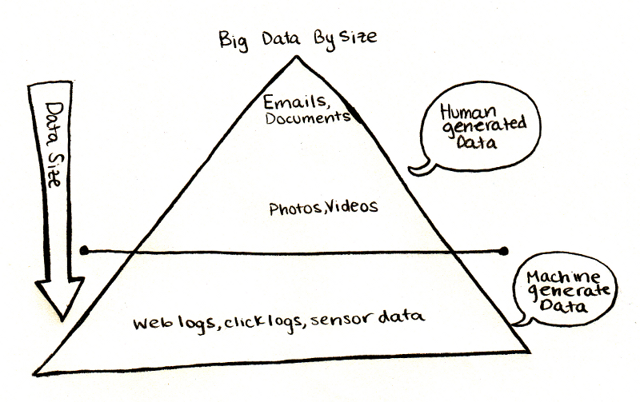
What is Big Data?
Big Data is very large, loosely structured data sets that defies traditional storage and access techniques.
Before 'Hadoop', machine generated data was ~ignored, not captured, as dealing with the volume was not possible, or not cost effective.

Slide 4
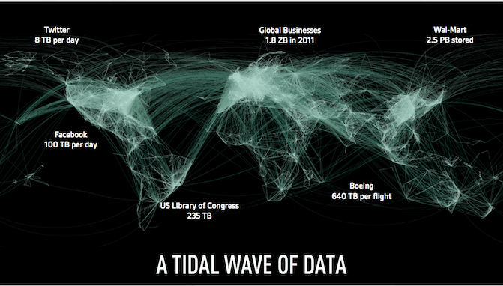
Massive amount of data, and this was 7 years ago
Yahoo : 60 PB of data
EBay : 40 PB of data, captures 50 TB / day

Slide 5
Challenges
Sheer size of Big Data
Most Big Data is unstructured.
For example click stream log data might look like time stamp, user_id, page, referrer_page
Lack of structure makes relational databases not well suited to store Big Data.
Not many databases can cope with storing billions of rows of data.
The traditional data processing model has data stored in a 'storage cluster', which is copied over to a 'compute cluster' for processing, and the results are written back to the storage cluster.
Doesn't work as copying so much data to a compute cluster would be too time consuming or impossible

Slide 6
Lets compare 3 types of stores https://docs.microsoft.com/en-us/azure/architecture/guide/technology-choices/data-store-overview
Key/value stores
Redis, Riak, Hadoop, Azure's tablestore
Document databases
Cosmos DB, MongoDB, OrientDB, CouchDB, Azure's DocumentDB, AWS DynamoDB
Column-family databases
Cassandra, Google's BigTable, Druid

Slide 7
Key/value stores
A key/value store is essentially a large hash table. You associate each data value with a unique key, and the key/value store uses this key to store the data by using an appropriate hashing function.
Most key/value stores only support simple query, insert, and delete operations. To modify a value (either partially or completely), an application must overwrite the existing data for the entire value.
An application can store arbitrary data as a set of values. The stored values are opaque to the storage system software. Any schema information must be provided and interpreted by the application. Essentially, values are blobs and the key/value store simply retrieves or stores the value by key.
Advantage is very fast read and write operations. Used by Hadoop, which we will go into next

Slide 8
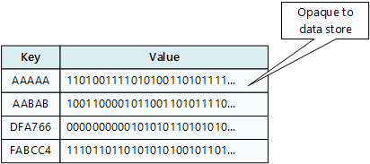
Key/value stores are highly optimized for applications performing simple lookups, but are less suitable for systems that need to query data across different key/value stores. Key/value stores are also not optimized for scenarios where querying by value is important, rather than performing lookups based only on keys. For example, with a relational database, you can find a record by using a WHERE clause, but key/values stores usually do not have this type of lookup capability for values

Slide 9
Document Databases
Well, mongo! We now know that one.
A document database is conceptually similar to a key/value store, except that it stores a collection of named fields and data (known as documents), each of which could be simple scalar items or compound elements such as lists and child collections. The data in the fields of a document can be encoded in a variety of ways, including XML, JSON, BSON,or even stored as plain text. Unlike key/value stores, the fields in documents are exposed to the storage management system, enabling an application to query and filter data by using the values in these fields.
Typically, a document contains the entire data for an entity. A single document may contain information that would be spread across several relational tables in an RDBMS.
A document store does not require that all documents have the same structure. This free-form approach provides a great deal of flexibility. Applications can store different data in documents as business requirements change.

Slide 10
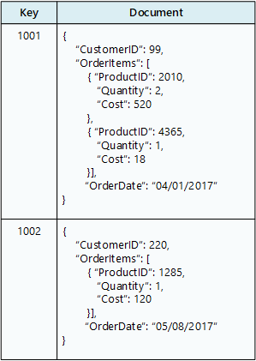
Since the data structure is described, the store can offer more function, such as indexing fields within the document, so then code is not limited to query only using the key. They allow fetching an entire page's data, so Facebook and Amazon use them.

Slide 11
Column-family databases
A column-family database organizes data into rows and columns. In its simplest form, a column-family database can appear very similar to a relational database, at least conceptually. The real power of a column-family database lies in its denormalized approach to structuring sparse data.
You can think of a column-family database as holding tabular data with rows and columns, but the columns are divided into groups known as column families. Each column family holds a set of columns that are logically related together and are typically retrieved or manipulated as a unit. Other data that is accessed separately can be stored in separate column families. Within a column family, new columns can be added dynamically, and rows can be sparse (that is, a row doesn't need to have a value for every column).
The following diagram shows an example with two column families, Identity and Contact Info. The data for a single entity has the same row key in each column-family. This structure, where the rows for any given object in a column family can vary dynamically, is an important benefit of the column-family approach, making this form of data store highly suited for storing structured, volatile data.

Slide 12
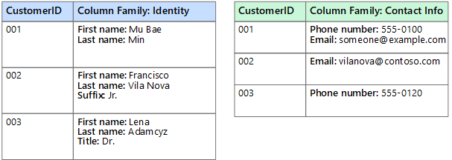
Unlike a key/value store or a document database, most column-family databases store data in key order, rather than by computing a hash. Many implementations allow you to create indexes over specific columns in a column-family. Indexes let you retrieve data by columns value, rather than row key. Lets you store any type of “named” (keyed) data in each row, but then the db can’t offer much functionality since every row can be completely different.

Slide 13
Hadoop is an open source software stack that runs on a cluster of machines.
Hadoop provides distributed storage and distributed processing for very large data sets.
Hadoop allows you to capture new types or more data
With Hadoop, you can store data longer ($ per Gbyte is cheaper)
Hadoop provides scalable analytics

Slide 14
As used by (this is a 7 year old slide!)
2012 US Presidential Election
How Big Data help Obama win re-election - by Michael Lynch
Dodd-Frank Compliance at a bank
leading retail bank is using Cloudera and Datameer to validate data accuracy and quality to comply with regulations like Dodd-Frank
A health IT company instituted a policy of saving seven years of historical claims and remit data, but to meet the data retention requirement while processing millions of claims every day required Hadoop
Monitoring patient vitals at Los Angeles Children's Hospital
Couldn’t collect billions of data points from sensors / machines attached to the patients so data had to be periodically purged
Nokia collects and analyzes vast amounts of data from mobile phones
Dealing with 100TB of structured data and 500TB+ of semi-structured data, 10s of PB across Nokia, 1TB / day

Slide 15
Hadoop has 2 major components and we will look at each.
A highly scalable, distributed, fault tolerant file system that runs on a cluster of cheap computers.
An implementation of the Map-Reduce paradigm that allows a problem to be farmed out and run on the CPUs of that same cluster of many cheap computers, and solved in parallel. (IF the nature of the problem is amenable to parallelization!)

Slide 16
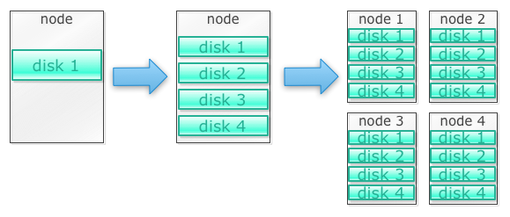
Hadoop: an important NoSQL implementation. Scale out storage and compute
Say we need to store lots of photos. We will start with a single disk. When we exceed a single disk, we may use a few disks stacked on a machine. When we max out all the disks on a single machine, we need to get a bunch of machines, each with a bunch of disks.

Slide 17
HDFS, or the Hadoop Distributed File System
HDFS gives the programmer effectively unlimited storage using horizontal scalability.
Thousands of servers holding petabytes of data.
When you need even more storage, you don't switch to more expensive solutions, but add more commodity servers.
Commodity hardware. HDFS is designed with relatively cheap commodity hardware in mind. It can be structured this way because HDFS is self-healing and replicating.
Fault tolerance.
Every member of the Hadoop stack knows how to deal with hardware failures. If you have 10 thousand servers, then you will see one server fail every day, on average. HDFS foresees that by replicating the data, by default three times, on different data node servers. Thus, if one data node fails, the other two can be used to restore the third one in a different place

Slide 18
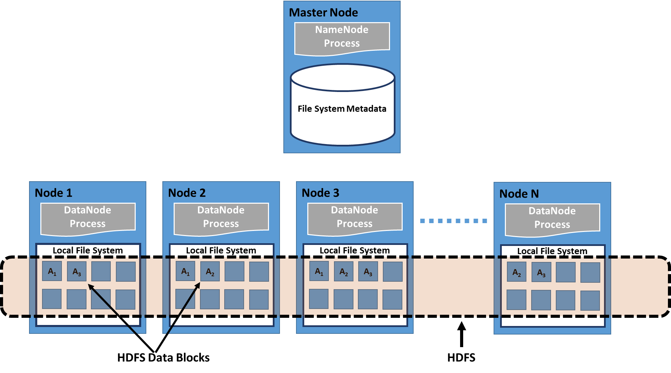
HDFS with replication factor of 3
3, 5, 7? Nodes run as ACID,
Eventual Consistency

Slide 19
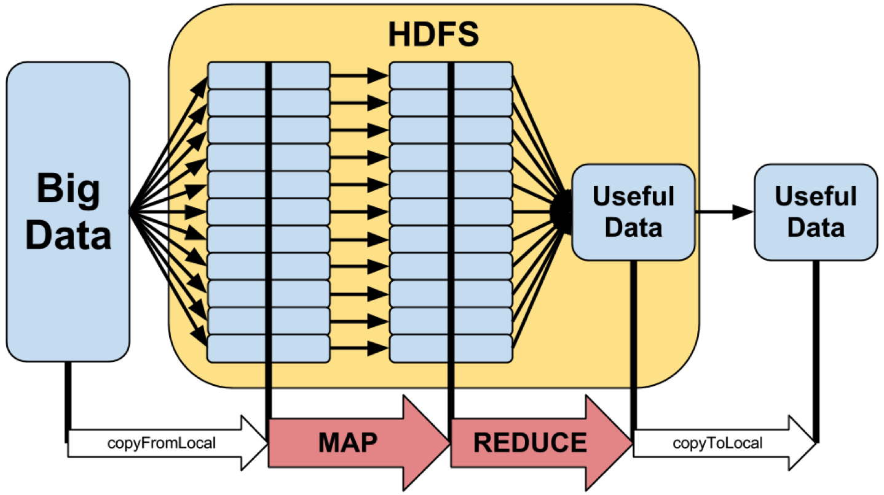

Slide 20
Hadoop clusters scale horizontally
More storage and compute power can be achieved by adding more nodes to a Hadoop cluster. This eliminates the need to buy more and more powerful and expensive hardware.
16 4way processers are much cheaper than one 64way processor
As long as you don’t need shared memory
Hadoop can handle unstructured / semi-structured data
Hadoop doesn't enforce a 'schema' on the data it stores. It can handle arbitrary text and binary data. So Hadoop can 'digest' unstructured data easily.
We’ll see later why this “good thing” is not always a good thing
Hadoop clusters provides storage and computing, so they scale together.

Slide 21
What does it take to use Hadoop?
Hadoop is written in Java. So knowing Java helps
Hadoop runs on Linux, so you should know basic Linux command line navigation skills
Some Linux scripting skills will go a long way (getting data formatted for input, exporting it, etc)
But you don't have to write Java Map Reduce code to extract data out of Hadoop.
You can use Hive’s SQL-like queries or a special data manipulation language, Pig.
They both convert your solution into a Java parallel map reduce implementation
>> We are going to run to Java map-reduce programs, and then put a toe into Pig

Slide 22
Pig - Big Data manipulation (more on this later)
Often Java is used to write the map and the reduce functions required. But since many data analysts don’t want to learn the full Java language just to do some straightforward data manipulation tasks, Pig was invented.
Pig is a language designed expressly just for expressing data manipulation (the code is called Pig Latin).
Pig allows you to manipulate large volumes of information, analyze them, and create new derivative data sets. Internally it creates a sequence of MapReduce jobs for you
So one can use this simple language to solve some classes of pretty sophisticated large-scale problems.

Slide 23
MapReduce is a programming framework.
Like other frameworks, the MapReduce framework does some things for you, and provides a place for you to fill in the blanks.
What MapReduce does for you is to organize your multiple computers in a cluster in order to perform the calculations you need.
It takes care of distributing the work between computers and of putting together the results of each computer's computation.
It takes care of hardware and network failures, so that they do not affect the flow of your computation.
You have to structure your problem into separate pieces which can be processed in parallel by multiple machines
You provide the code to do the actual calculations in each clone

Slide 24
There are other important parts in the Hadoop system we will not cover
ZooKeeper is an example. If you are trying to configure, maintain, and run software across a farm of 100 computers, it can be quite a challenge.
ZooKeeper is a centralized service for maintaining configuration information, naming, providing distributed synchronization, and providing group services. ZooKeeper is also fault-tolerant. In your development environment, you can put the zookeeper on one node, but in production you usually run it on an odd number of servers, such as 3 or 5.

Slide 25
MapReduce
MapReduce has a master and workers.
The master assigns a portion of the work to the next available worker; thus, no work portion is forgotten or left unfinished. Might be 100 portions, only 20 workers.
Workers send periodic heartbeats to the master. If the worker is silent for a period of time (usually 10 minutes), then the master presumes this worker crashed and assigns its work to another worker. The master also cleans up the unfinished portion of the crashed worker.
All of the data resides in HDFS, which avoids the central server concept, with its limitations on concurrent access and on size. MapReduce never updates data, rather, it writes new output instead. This is avoids update lockups.
MapReduce is network and rack aware, and it optimizes the network traffic.

Slide 26
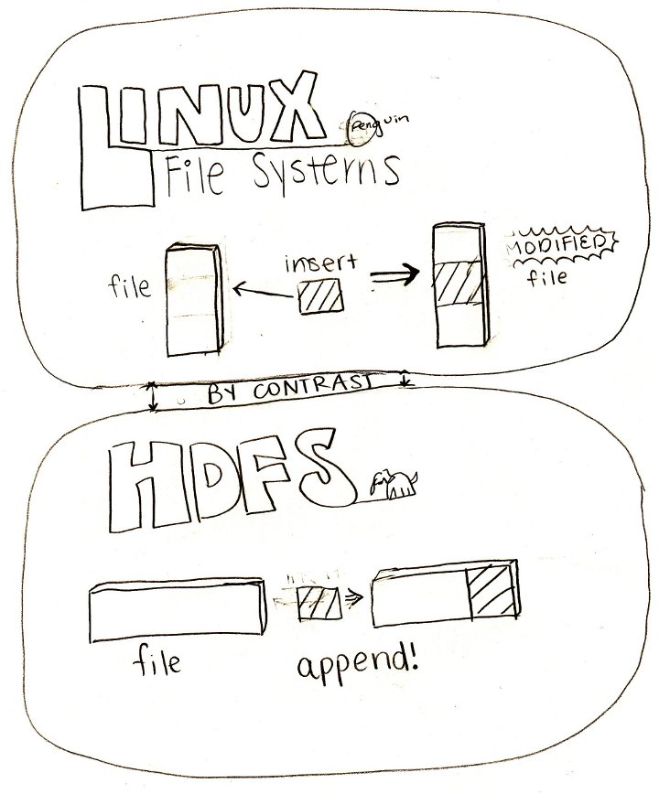

Slide 27
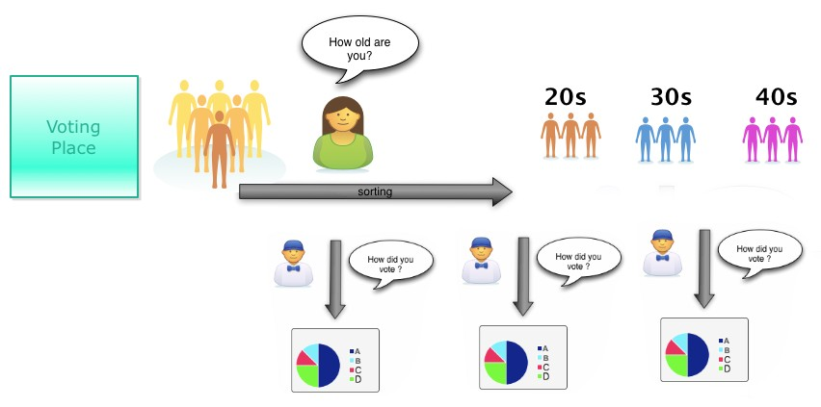
MapReduce analogy : Exit Polling
a “sorter”
mapper
a reducer
Can have multiple Mappers and multiple Reducers, all running in parallel.
The result for one age group is not influenced by the result of other age group.
So they can be processed in parallel.

Slide 28
Very good tutorial https://developer.yahoo.com/hadoop/tutorial/
Another tutorial:
http://hadoop.apache.org/docs/current/hadoop-mapreduce-client/hadoop-mapreduce-client-core/MapReduceTutorial.html

Slide 29
Mapper maps input key/value pairs to a set of intermediate key/value pairs. “Maps” are the individual tasks that transform input records into intermediate records.
Output pairs do not need to be of the same types as input pairs. A given input pair may map to zero or many output pairs. Output pairs are collected with calls to context.write(WritableComparable, Writable).
Applications can use the Counter to report its statistics.
All intermediate values associated with a given output key are subsequently grouped by the framework, and passed to the Reducer(s) to determine the final output. Users can control the grouping by specifying a Comparator via Job.setGroupingComparatorClass(Class).
The Mapper outputs are sorted and then partitioned per Reducer. The total number of partitions is the same as the number of reduce tasks for the job. Users can control which keys (and hence records) go to which Reducer by implementing a custom Partitioner.
Users can optionally specify a combiner, via Job.setCombinerClass(Class), to perform local aggregation of the intermediate outputs, which helps to cut down the amount of data transferred from the Mapper to the Reducer.
The intermediate, sorted outputs are always stored in a simple (key-len, key, value-len, value) format.

Slide 30
Reducer reduces a set of intermediate values which share a key to a smaller set of values.
Overall, Reducer implementations are passed the Job for the job via the Job.setReducerClass(Class) method and can override it to initialize themselves.
Reducer has 3 primary phases: shuffle, sort and reduce.
Shuffle: Input to the Reducer is the sorted output of the mappers. In this phase the framework fetches the relevant partition of the output of all the mappers, via HTTP.
Sort: The framework groups Reducer inputs by keys (since different mappers may have output the same key) in this stage.
The shuffle and sort phases occur simultaneously; while map-outputs are being fetched they are merged.
Secondary Sort: If equivalence rules for grouping the intermediate keys are required to be different from those for grouping keys before reduction, then one may specify a Comparator via Job.setSortComparatorClass(Class). Since Job.setGroupingComparatorClass(Class) can be used to control how intermediate keys are grouped, these can be used in conjunction to simulate secondary sort on values.
Reduce: In this phase the reduce(WritableComparable, Iterable<Writable>, Context) method is called for each <key, (list of values)> pair in the grouped inputs.
The output of the reduce task is typically written to the FileSystem via Context.write(WritableComparable, Writable).
Applications can use the Counter to report its statistics.
The output of the Reducer is not sorted.

Slide 31

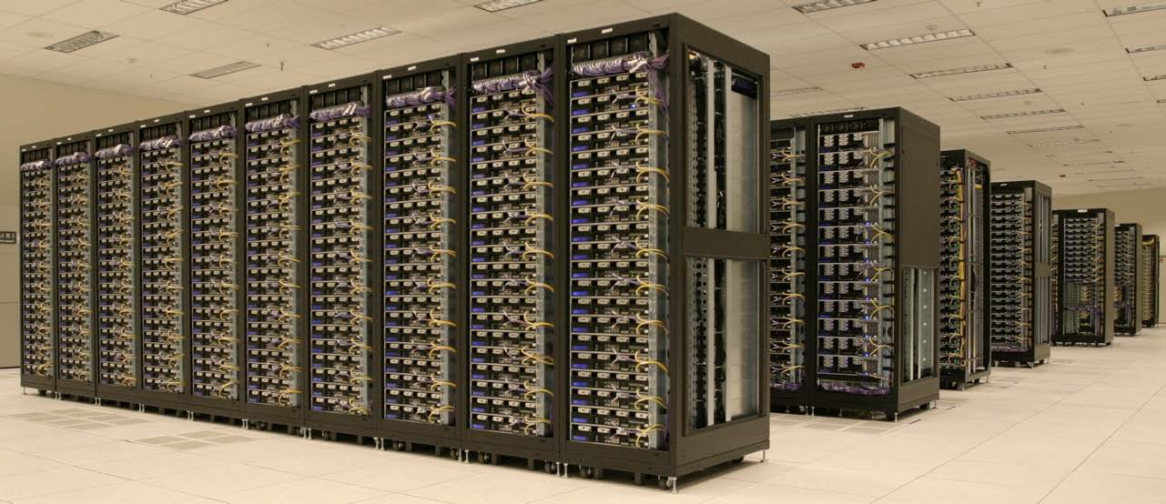
Amazon and Microsoft offer Hadoop in the Cloud
Scale out to hundreds of systems quickly, process the data, and then give back the systems to the pool.
Much more economic than buying large collections of own systems.
azure data center vid
https://www.facebook.com/visualstudio.us/videos/1885175121712910/

Slide 32
Are these NoSQL approaches better than SQL? http://www.slideshare.net/marin_dimitrov/nosql-databases-3584443
Advantages
Massive scalability
High Availability
Lower cost at these large scales
Predictable elasticity
Schema flexibility, spares and semi-structured data
Disadvantages
Limited query capability
“Eventual Consistency” (Not ACID, see next slides)
Not appropriate for many situations
Not intuitive to write good code for (makes client apps more complicated)
No standardization, so portability is an issue
Insufficient access control

Slide 33
ACID (Atomicity, Consistency, Isolation, Durability)
Atomicity
Atomicity requires that each transaction be "all or nothing": if one part of the transaction fails, the entire transaction fails, and the database state is left unchanged, even if there are power failures, errors, and crashes.
Consistency
The consistency property ensures that any transaction will bring the database from one valid state to another. Any data written to the database must be valid according to all defined rules, including constraints, cascades, triggers, and any combination thereof. This does not guarantee correctness of the transaction in all ways the application programmer might have wanted, that is the responsibility of application-level code.
Isolation
The isolation property ensures that the concurrent execution of transactions results in a system state that would be obtained if transactions were executed serially, i.e., one after the other. Providing isolation is the main goal of concurrency control.
Durability
Durability means that once a transaction has been committed, it will remain so, even in the event of power loss, crashes, or errors. In a relational database, for instance, once a group of SQL statements execute, the results need to be stored permanently (even if the database crashes immediately thereafter) so transactions must be recorded in a non-volatile memory.

Slide 34
CAP theorem, also known as Brewer's theorem
States it is impossible for a distributed computer system to simultaneously provide all three of the following guarantees
Consistency (all nodes see the same data at the same time)
Availability (a guarantee that every request receives a response about whether it succeeded or failed)
Partition tolerance (the system continues to operate despite arbitrary message loss or failure of part of the system)
Generally agreed that you can have only "two out of three" , however that concept can be misleading or misapplied, and one must dig into the details of the implementation and intended use to decide the acceptability.

Slide 35
Some Tradeoff choices that might be acceptable
Use 2 phase commits, but this means that when a partition occurs, the system must block (loss of availability)
Some of the data is not accessible, but the rest is. (loss of availability)
System is still available during a partition, but some of the data may be inaccurate.
DNS is classic example

Slide 36
More places to read
Practical illustration of Map-Reduce (Hadoop-style), on real data
http://www.datasciencecentral.com/profiles/blogs/practical-illustration-of-map-reduce-hadoop-style-on-real-data
This link has a distribution of Hadoop, and learning items such as videos
http://www.cloudera.com/content/cloudera/en/home.html
This site has tons of data, tutorials, including a nice detailed explanation of the word count example that everyone uses.
http://hadoop.apache.org/docs/current/hadoop-mapreduce-client/hadoop-mapreduce-client-core/MapReduceTutorial.html
Good slide presentation
http://www.slideshare.net/marin_dimitrov/nosql-databases-3584443

Slide 37
Many publicly available data sets (you need these for your final project.)
20 Big Data Repositories You Should Check Out
http://www.datasciencecentral.com/profiles/blogs/20-free-big-data-sources-everyone-should-check-out
NYT’s The Movie Reviews API
http://developer.nytimes.com/docs/movie_reviews_api/
The online book has a long list at the end
http://hadoopilluminated.com/hadoop_illuminated/index.html
Govt data
https://www.data.gov/

Slide 38
We will now run some Hadoop problems

